Slide 1



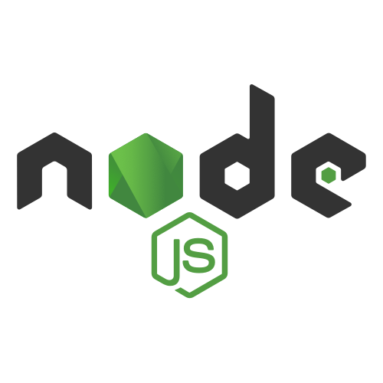
INTRENSHIP PRESENTATION
WELCOME

Slide 2
GOALS OF INTERNSHIP
Internships provide an opportunity for us to apply theoretical knowledge to real-world situations. They aim to enhance and develop practical skills that are relevant to the industry.
Internships offer a chance to gain valuable experience in a professional setting.
Internships allow individuals to connect with professionals in their field. Building a network can open up future job opportunities, provide mentorship, and offer Insights into the industry.
Internships often involve working within a team. Learning to collaborate with colleagues, understanding team

Slide 3
About This Intrenship
In this internship we worked on the ‘Food Delivery System’ project.
It is based on the MERN Stack , which we use four different technologies that work together to develop dynamic web app.
We use React.js for the front-end-display,
Node.js and Express.js for the application tier
And MongoDB for the Database.
We use above technologies to develop this web based application.

Slide 4
ONLINE FOOD DELIVERY SYSTEM
PREREQUITES FOR MERN STACK:
HTML
CSS
JAVASCRIPT(NODE.JS,REACT.JS)
MONGODB
EXPRESJS
KNOWLEDGE OF DATABASE
API AND WORKING

Slide 5
FUNCTIONAL MODULES: 1)REGISTER AND LOGIN MODULE 2)FOOD CATEGORY : ADD CATEGORY, DELETE CATEGORY, VIEW CATEGORY 3)FOOD MODULE : ADD FOOD, UPDATE FOOD, DELETE FOOD, VIEW FOOD,SEARCH FOOD 4)CART MODULE : ADD TO CART, DELETE TO CART , VIEW CART 5)ORDER MODULE : ADD ORDER, VIEW ORDERS,CONFIRM ORDER 6)DELIVERY MODULE : ADD DELIVERY DETAIL,VIEW DELIVERY DETAIL

Slide 6

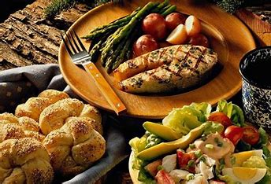

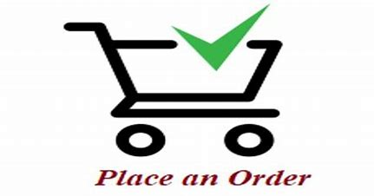
User Login or Register
View and Search for desired food
Add to Cart
Order the food

Slide 7
INTRODUCTION
MERN STANDS FOR MONGODB,EXPRESS,REACT,NODE,AFTER
THE FOUR KEY TECHNOLOGIES THAT MAKE UP THE STACK THAT IS USED FOR EASIER AND FASTER DEVELOPMENT
HOW DOES MERN STACK WORK?
THE MERN ARCHITECTURE ALLOWS YOU TO EASILY CONSTRUCT A 3-TIER ARCHITECTURE ENTIRELY USING JAVASCRIPT AND JSON
PUTTING IT ALL TOGETHER IN THE CONTEXT OF A FOOD DELIVERY APP:
A USER LOGS INTO THE APP (UI BUILT WITH REACT).
THE USER SEARCHES FOR A RESTAURANT. THE REQUEST GOES TO THE SERVER (EXPRESS.JS RUNNING ON NODE.JS).
THE SERVER FETCHES RELEVANT RESTAURANT DATA FROM MONGODB.

Slide 8
THIS DATA IS SENT BACK TO THE FRONT-END AND DISPLAYED TO THE USER (AGAIN USING REACT).
THE USER SELECTS A RESTAURANT, VIEWS THE MENU, AND PLACES AN ORDER.
THE ORDER DETAILS ARE SENT TO THE SERVER (USING EXPRESS.JS), WHICH THEN SAVES THIS DATA IN MONGODB.

Slide 9
MONGODB
NOSQL DATABASE USED FOR HIGH-VOLUME DATA STORAGE.
OPEN-SOURCE DOCUMENT-ORIENTED DATABASE.
IT STORES DATA IN JSON FORMAT.
CAN BE EASILY USED WITH NODE.
DOCUMENTS CONTAINING KEY-VALUE PAIRS ARE THE BASIC UNITS OF MONGO DB.
WHY MONGODB?
SCALABILITY: MONGODB'S SCALE-OUT ARCHITECTURE SUPPORTS APPLICATIONS THAT NEED TO GROW, ADAPTING TO INCREASED DATA VOLUME OR USER LOAD.

Slide 10
SCHEMA FLEXIBILITY: MONGODB ALLOWS DEVELOPERS TO STORE STRUCTURED OR UNSTRUCTURED DATA. THIS IS BENEFICIAL WHEN THE DATA SCHEMA IS SUBJECT TO CHANGE, WHICH CAN OFTEN HAPPEN IN ITERATIVE DEVELOPMENT OR STARTUPS .
PERFORMANCE: MONGODB CAN OFFER HIGH PERFORMANCE FOR READ AND WRITE OPERATIONS, ESPECIALLY WHEN OPTIMIZED WITH PROPER INDEXING.
JSON-LIKE DOCUMENTS: THE USE OF BSON FORMAT (BINARY JSON) PROVIDES AN INTUITIVE DATA MODEL FOR DEVELOPERS FAMILIAR WITH JSON AND JAVASCRIPT.

Slide 11
NODE.JS: *NODE.JS ALLOWS YOU TO RUN JAVASCRIPT ON THE SERVER. *IT IS FREE AND OPEN SOURCE,WRITTEN IN C++. *NODE.JS RUNS SINGLE THREADED, NON-BLOCKING,ASYNCHRONOUS PROGRAMMING,WHICH IS VERY MEMORY EFFICIENT. WHERE TO USE NODE JS? *BACK-END SERVICES SUCH AS APIS. *HIGHLY SCALABLE,DATA-INTENSIVE AND REAL TIME APPS. *NODE.JS IS NOT USED IN CPU-INTENSIVE APPS WHICH REQUIRES CALCULATIONS DONE BY CPU.

Slide 12
EXPRESS JS:
FLEXIBLE NODE.JS FRAMEWORK THAT PROVIDES ROBUST OF FEATURES FOR WEB AND MOBILE APPLICATION. IT PROVIDES EASY ROUTING OF REQUESTS BASED ON HTTP METHODS AND URLS IT ALLOWS TO SETUP MIDDLEWARES TO RESPOND TO HTTP REQUESTS

Slide 13
REACT JS: *A JAVASCRIPT LIBRARY FOR BUILDING USER INTERFACESFOR WEB AND MOBILE APPLICATIONS. *REACT IS USED TO BUILD SINGLE-PAGE APPLICATIONS. *REACT ALLOWS US TO CREATE REUSABLE UI COMPONENETS. *REACT-ROUTER TO HANDLE THE FRONT-END ROUTING. WHY REACT? *REACTJS SUPPORTS COMPONENETS.THESE COMPONENTS ALSO PROMOTES CODE REUSABILITY AND MAKE OVERALL WEB APPLOICATION EASIER TO UNDERSTAND AND DEBUG. *REACT CREATES A VIRTUAL DOM MEMORY, WHERE IT DOES ALL NECESSARY MANIPULATING , BEFORE MAKING THE CHANGES IN BROWSER DOM.

Slide 14
API • API stands for Application Programming Interface. It is a set of rules that allows different applications to communicate with each other and exchange information or functionality How APIs are working • APIs work by sharing data between applications, systems, and devices. • One application sends a request and is known as the API client, while the other application sends a response. • APIs follow the HTTP protocol to communicate, which has a specific request and response structure.

Slide 15
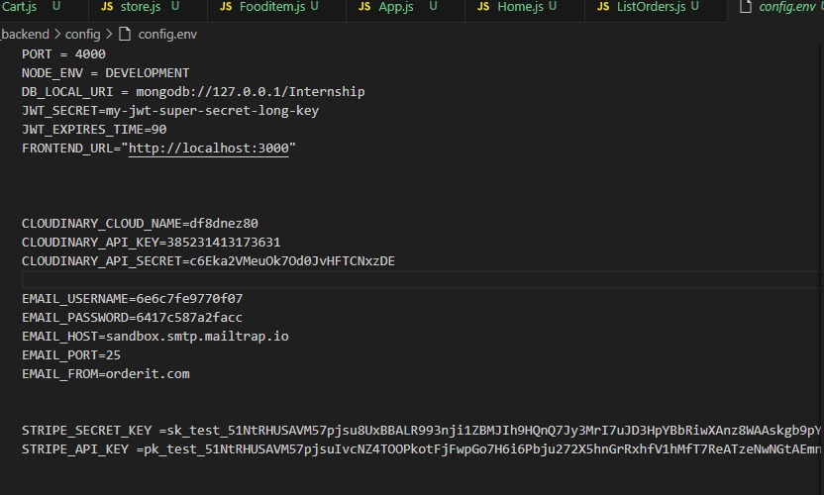
FETCHING OF API

Slide 16
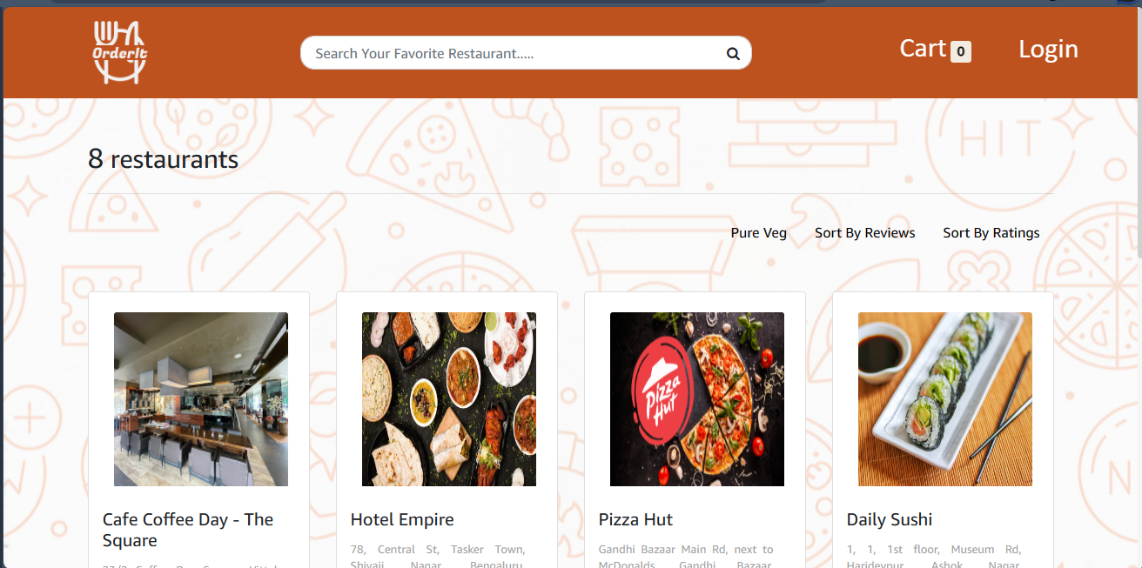
Home page

Slide 17
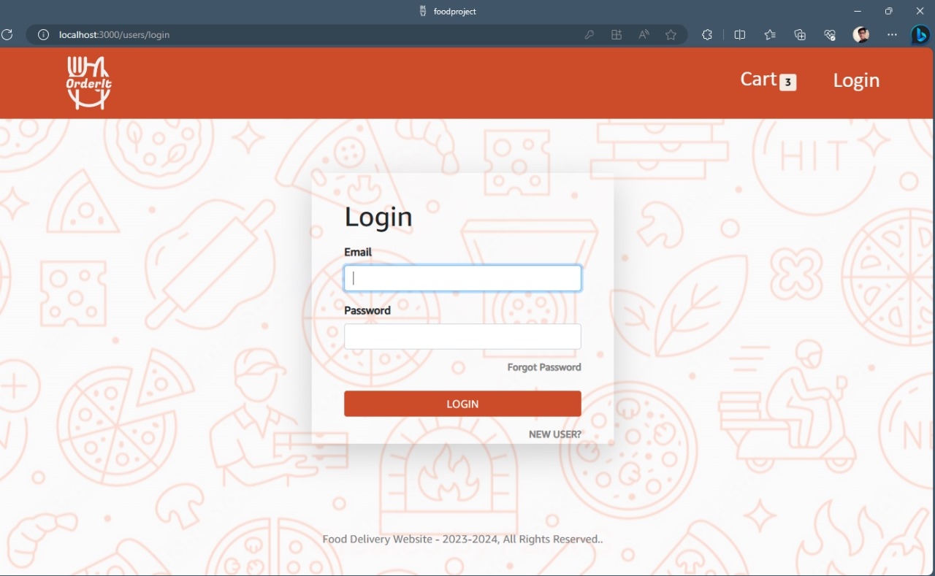
Login and Register Page

Slide 18
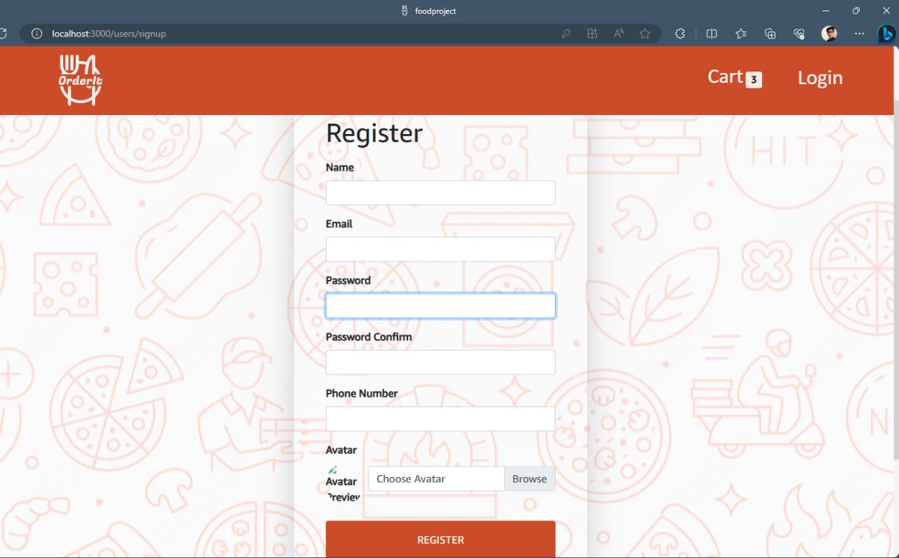

Slide 19
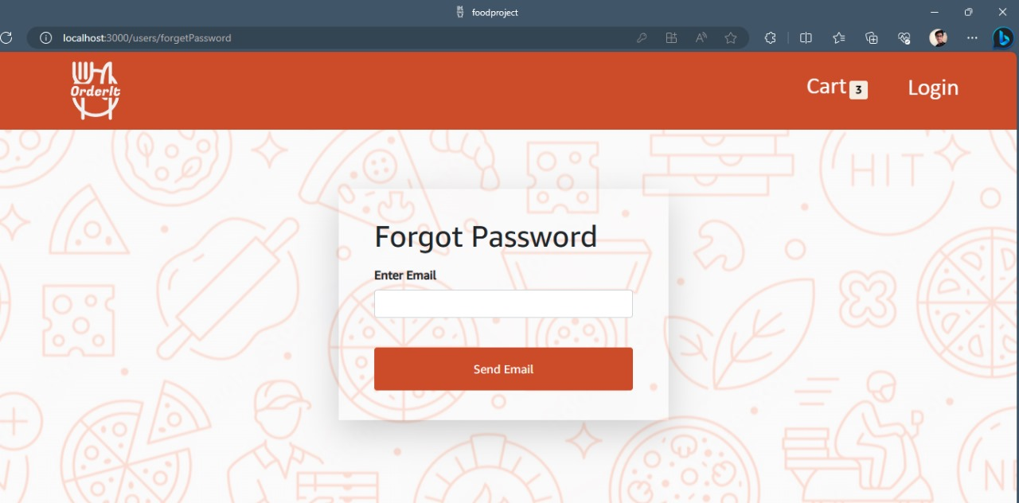
Forget Password

Slide 20
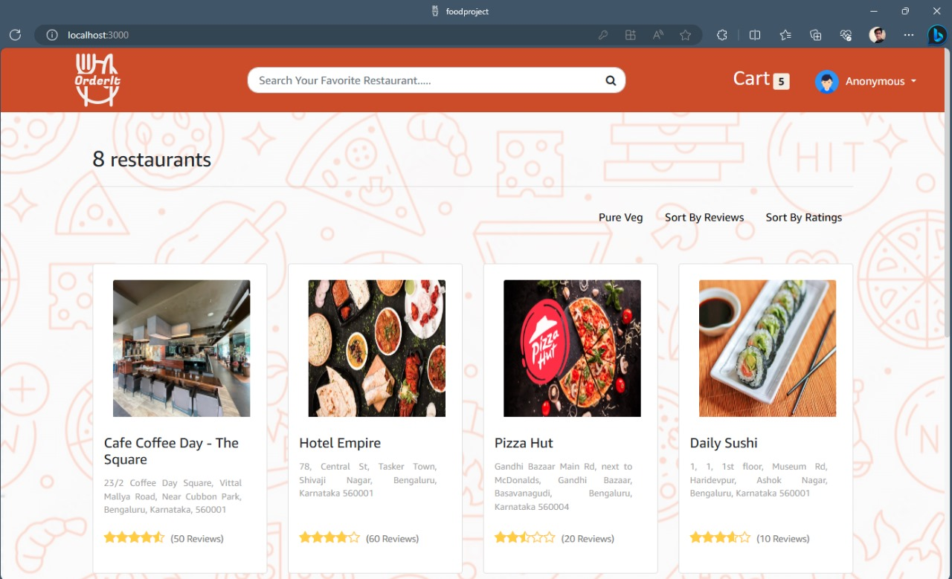
Home page after successful Login

Slide 21
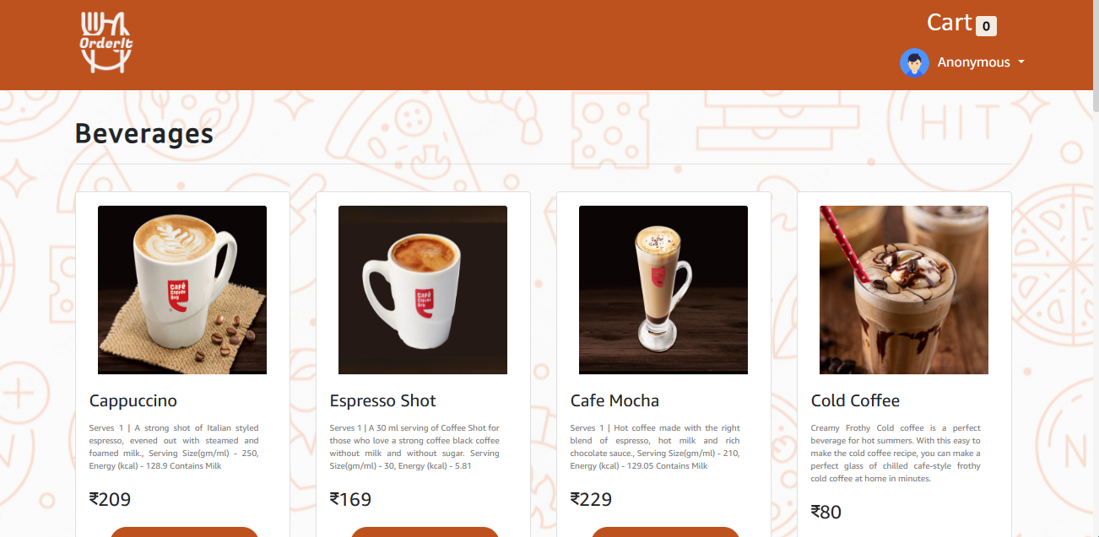
Menu for view of different restaurants

Slide 22
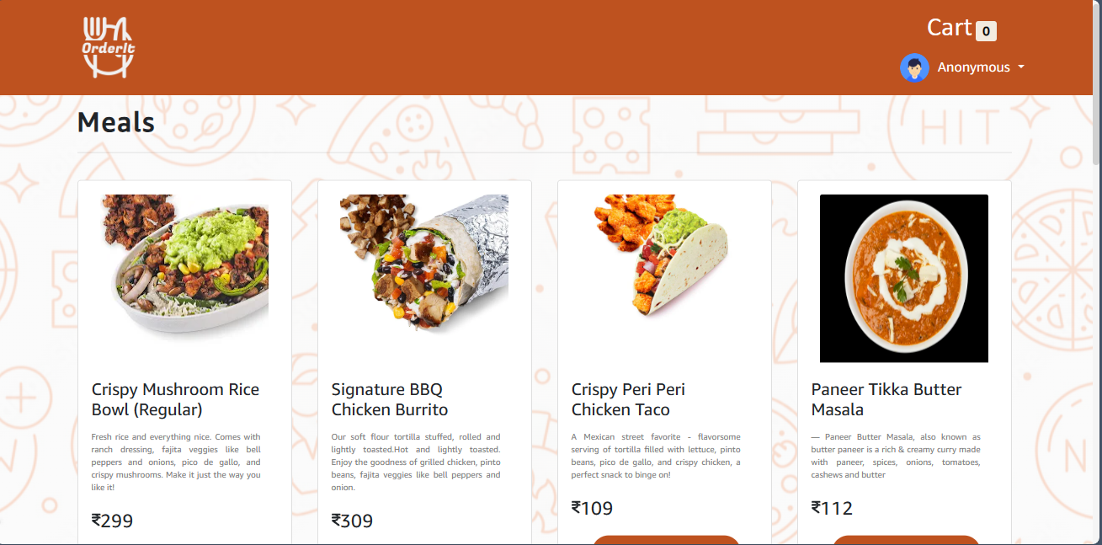

Slide 23
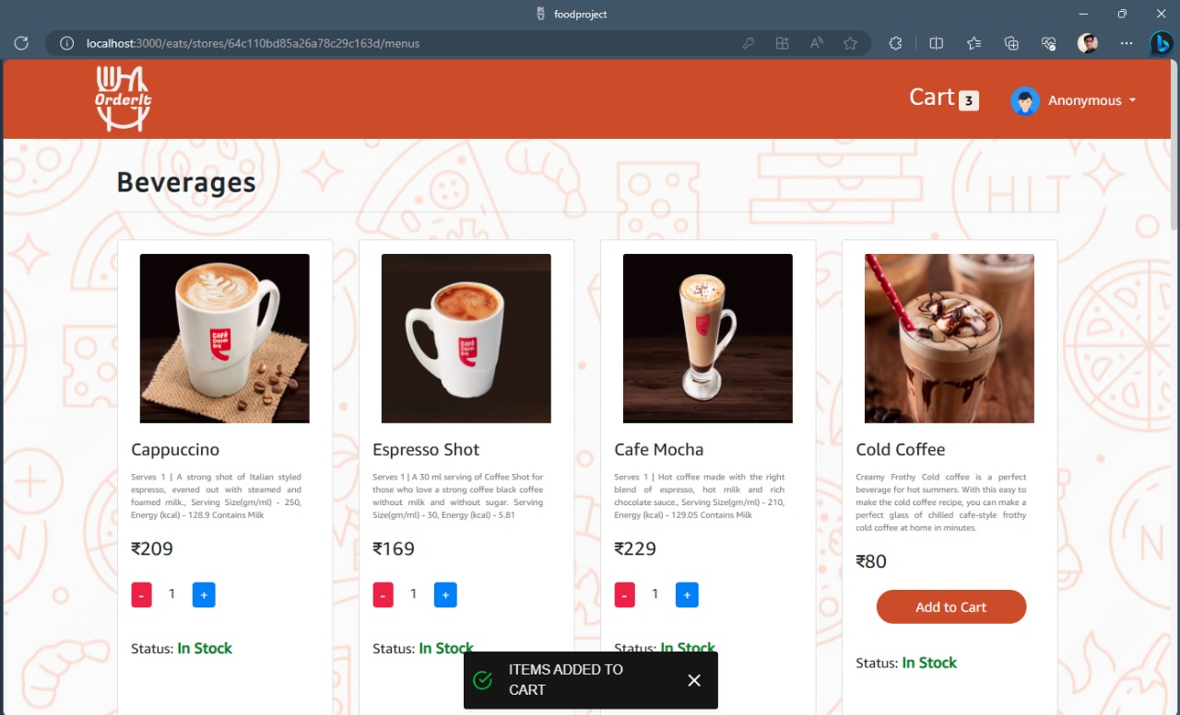
Adding food to cart

Slide 24
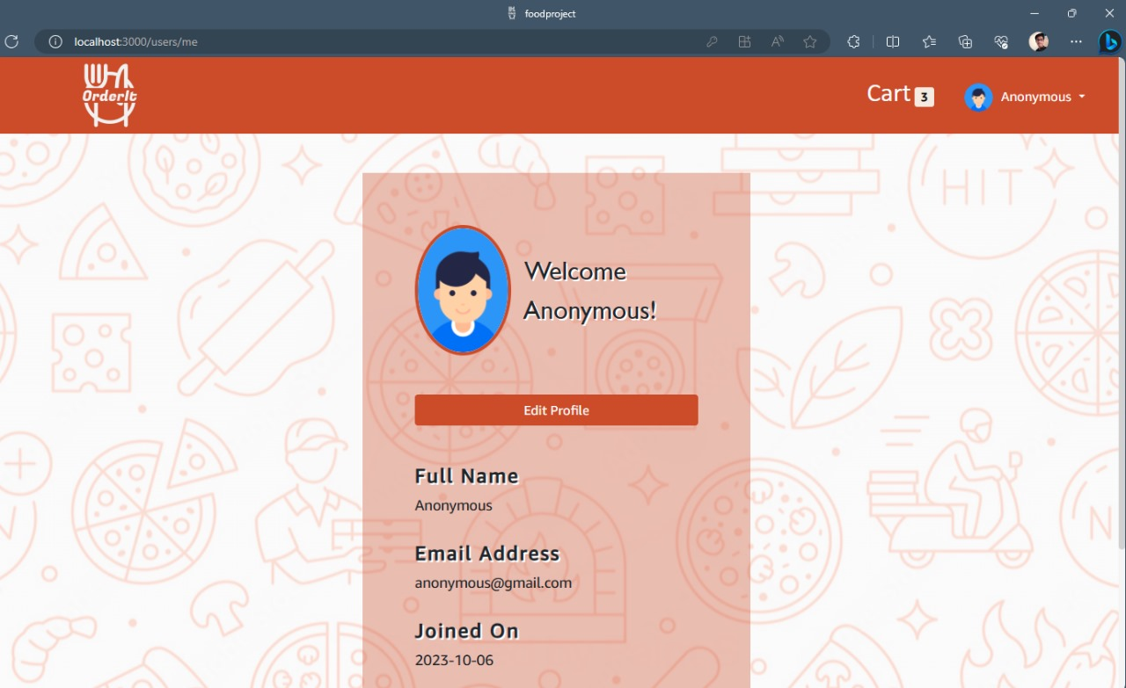
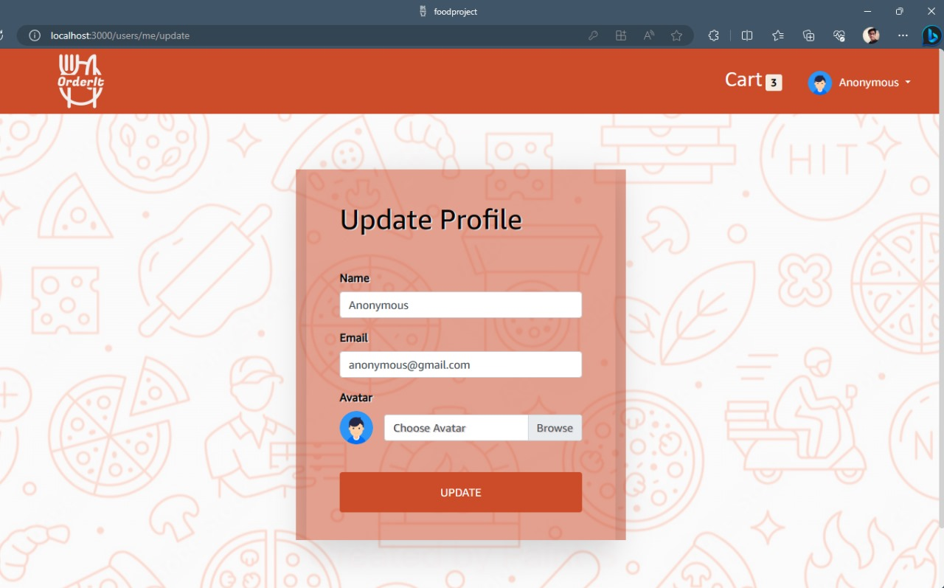
View User Profile and Update profile

Slide 25
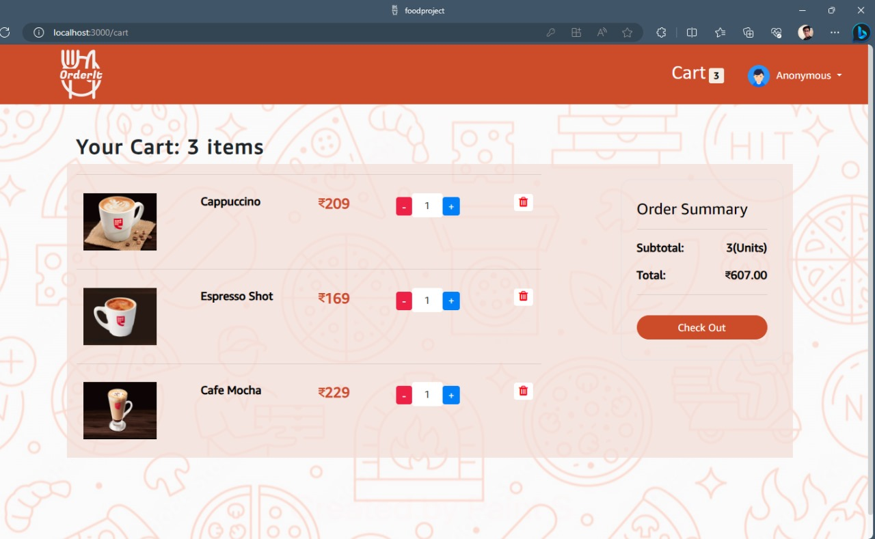
Added Items in Cart

Slide 26
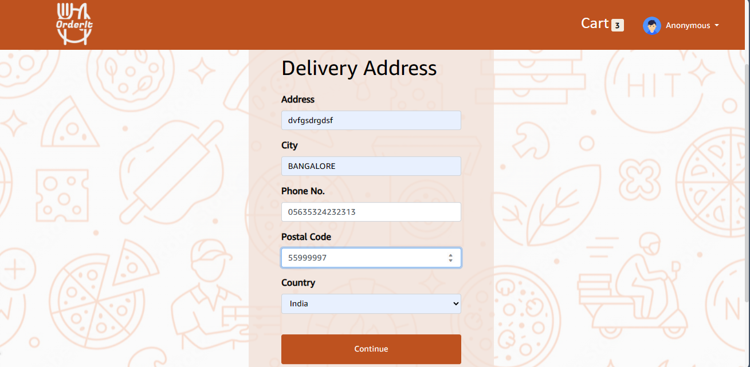
Adding delivery address and details Before ordering

Slide 27
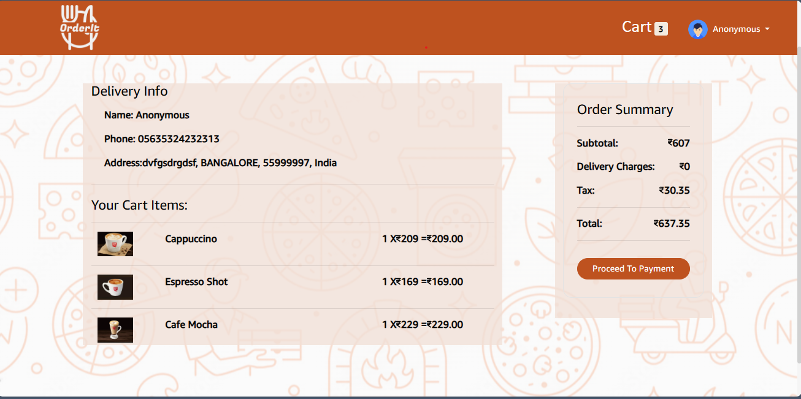
Delivery Info and Card Detail

Slide 28
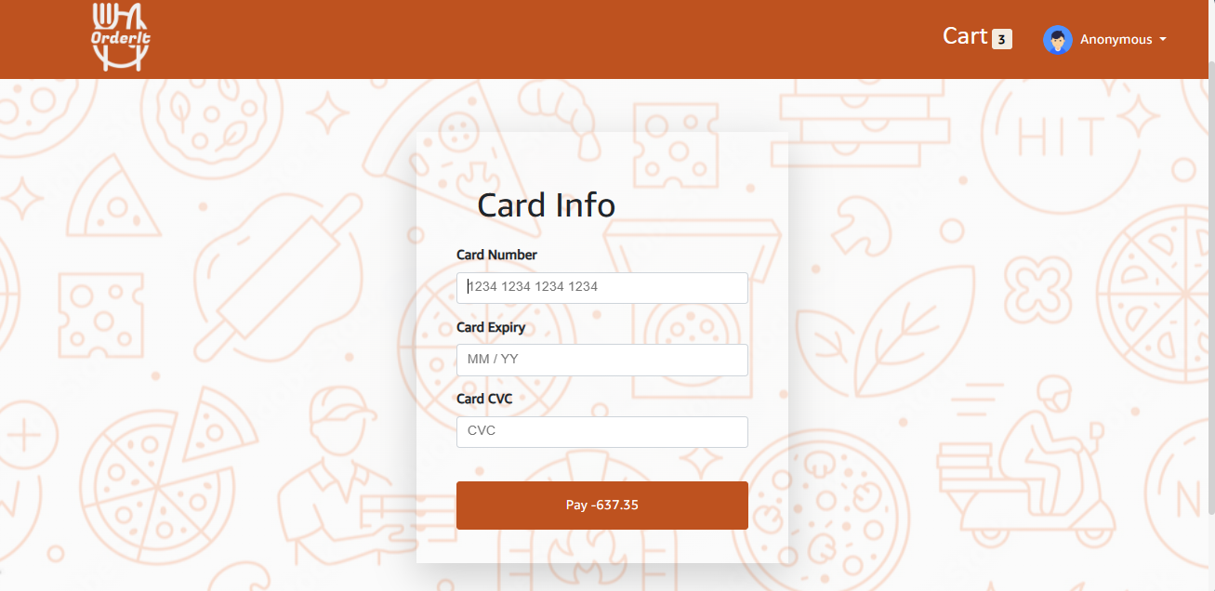
Adding card details

Slide 29
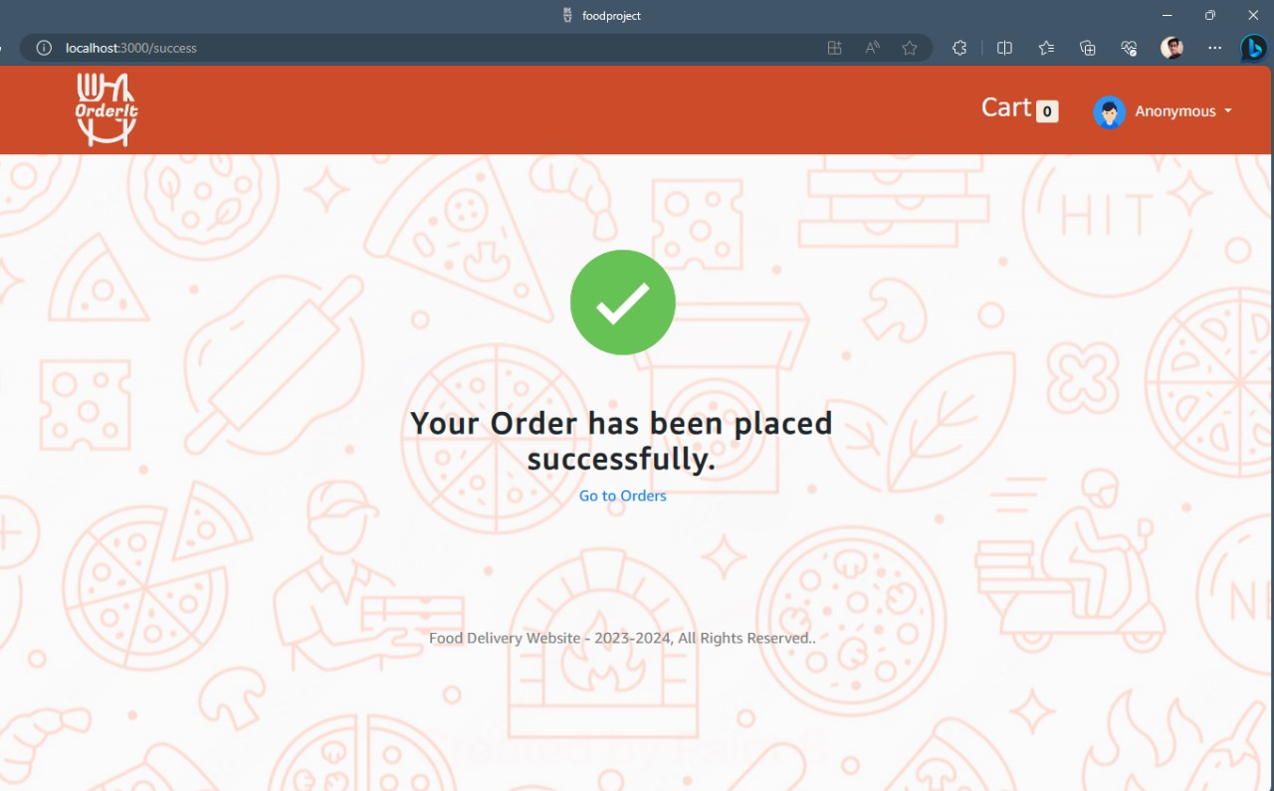
Order Placed

Slide 30
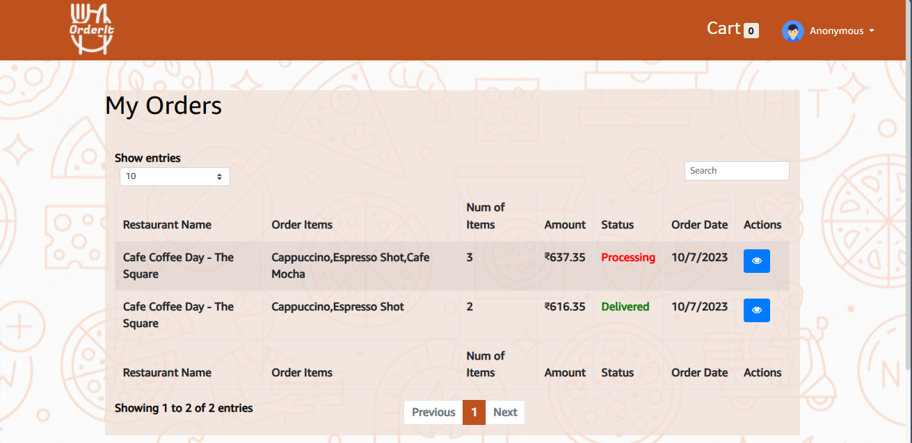
MY Orders

Slide 31
Thank you🙂

